Slide 1

AUTOMATED PLANT WATERING SYSTEM

Slide 2
INTRODUCTION
An automated irrigation of plants is a system, either operated by a computer or a timer, which is able to water plants with a minimum of physical effort. Such ways of watering plants are less elaborate and can be more rapid than manual application, and even assist in delivering to the plants exactly the required amount of moisture. Management of higher flow rates. Accurate cut-off of water compared to manual checking. Reduced runoff of water

Slide 3
OBJECTIVE
The objective of this project is to develop an automated plant watering system that optimizes water usage by predicting the required watering amount based on environmental conditions. The system collects real-time data on temperature, humidity, and soil moisture using sensors connected to an Arduino. This data is then sent to a Raspberry Pi, where a machine learning model processes the inputs and predicts the optimal amount of water needed for the plant. The system ensures efficient water management by automating the watering process based on data-driven predictions, reducing water wastage and maintaining optimal soil moisture levels for plant health.

Slide 4
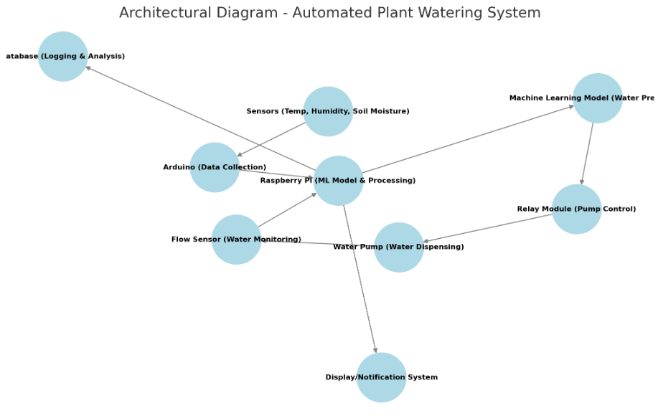
ARCHITECTURE DIAGRAM

Slide 5
METHODS
1. System Overview
The proposed system automates plant watering based on three environmental parameters: temperature, humidity, and soil moisture. These inputs are collected via sensors connected to an Arduino, which transmits the data to a Raspberry Pi. A machine learning (ML) model, running on the Raspberry Pi, processes the data and predicts the required amount of water. The system then controls a pump to dispense the predicted water volume efficiently.
2. Hardware Components
Arduino Uno – Collects sensor data.
Raspberry Pi (Model 3B+) – Runs the ML model and sent the data to Arduino.
DHT11/DHT22 Sensor – Measures temperature and humidity.
Soil Moisture Sensor – Measures the moisture level of the soil.
Water Pump with Relay Module – Controls water flow.
Water Level Sensor – Detects the water level in the tank.
Power Supply (Battery or Adapter) – Powers the components.

Slide 6
METHODS
3. Software Components
Arduino IDE – For programming the Arduino.
Python (on Raspberry Pi) – To process data and interact with the ML model.
Machine Learning Model (Trained using Python, TensorFlow/Scikit-learn) – Predicts watering needs.
Communication Protocols: Serial – Enables data exchange between Arduino and Raspberry Pi.
4. Data Collection and Preprocessing
Sensor Integration:
The Arduino continuously collects real-time temperature, humidity, and soil moisture data from sensors.
This data is transmitted to the Raspberry Pi via serial communication (USB).
Data Logging:
The Raspberry Pi stores the received sensor readings in a structured format

Slide 7
METHODS
5. Machine Learning Model Implementation
Model Selection:
A Linear regression model is used.
The model is trained on a dataset containing historical temperature, humidity, soil moisture values, and the corresponding water amount required.
Training & Evaluation:
The model is trained using past environmental data.
Performance is evaluated using metrics like Mean Squared Error (MSE).
The best-performing model is deployed on the Raspberry Pi.
Real-Time Prediction:
When new sensor readings arrive, the model predicts the required water amount.

Slide 8
METHODS
6. Water Dispensing Mechanism
Water Flow Control:
After receiving the predicted water amount, the system first checks the water level in the tank using the water level sensor.
If the tank is empty, a notification is sent to refill it before proceeding.
If the tank has enough water, the relay module activates the pump to dispense water.
If the required amount is less than or equal to the available water, the process continues smoothly.
If the required amount exceeds the available water, the system dispenses the entire tank amount, then pauses, requests a refill, and resumes watering after the refill is completed.
Handling Edge Cases:
If the soil moisture is already high, the system avoids unnecessary watering.
The system ensures that sensors are paused during watering to prevent inaccurate readings.
After watering, the sensors and camera resume operation to reassess the moisture level.

Slide 9
METHODS
7. Testing & Deployment
System Calibration:
Sensors are calibrated to ensure accurate readings.
Initial watering cycles are tested to validate ML model accuracy.
Performance Testing:
The system is run for multiple cycles to measure efficiency and adjust any inconsistencies.
Final Deployment:
Once validated, the system is deployed for continuous plant watering automation.

Slide 10
CONCLUSION
The automated plant watering system is a reliable and efficient solution for plant care. By leveraging sensors, microcontrollers, and microprocessor, the system optimizes water usage, reduces labor costs, and promotes healthy plant growth. With real-time monitoring and control, users can ensure their plants receive the right amount of water at the right time. This system is ideal for greenhouses, gardens, and indoor plants, and can be customized to accommodate various plant species and environmental conditions.

